Slide 1


GCSE Options Process
2024
Miss O’Neill- Deputy Headteacher
Mr Brodigan- Assistant Headteacher
Mr Baxter -Head of Year 9

Slide 2
Making choices
Here are some things you need to know, do and think about...
The law says you must stay in learning until the age of 18.
Learning includes sixth form, college, training, or full time work as long as it includes some part time learning e.g. an apprenticeship.
You pick GCSEs options in Year 9.
You usually pick your next step in Year 11.

Slide 3
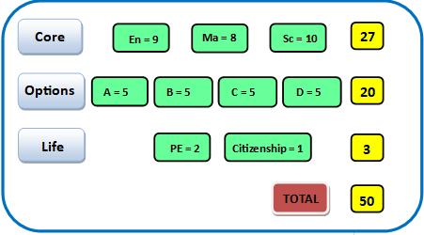
Curriculum in Year 10 & 11

Slide 4

The Choices

Slide 5
Guided Choices
We are ambitious for you to have the same chances as students in all other schools, so the EBacc is core to our curriculum offer:
All students MUST choose either History or Geography.
The majority of students are EXPECTED to choose a language.

Slide 6
EBacc Humanities
Geography
History
EBacc MFL
French
German
Optional Curriculum
Art and Design
Business
Creative Media
Design and Technology
Games Development Media
Information Technology
Music
Performing Arts
Photography
Religious Studies
Sociology
Sport
Food Preparation and Nutrition
Psychology
When choosing it is important to note that some options subjects cannot be studied together- this is because they are considered variations of the same qualification.
These subjects have been highlighted: Art and Design & Photography, Creative Media & Games Development Media.

Slide 7
Triple Science or Double Science?
3% of schools with a similar cohort to our school have all students take Triple Science.
13% of schools with a similar cohort do not allow any students to take Triple Science.
Of the remainder it is split roughly 50:50 as to whether the students or school decides who takes Triple Science.
All students will start Triple Science and differentiate at the end of Year 10.

Slide 8
The ‘new style’ GCSEs
  More rigorous - harder
  Bigger – more content
  Tiers only when necessary
  Linear with terminal exam – little chance to resit (except English and Maths post 16)
  No coursework except in a few subjects (The Arts, Design Technology, Food etc.)
  And… a new (ish!) grading system

Slide 9


Slide 10
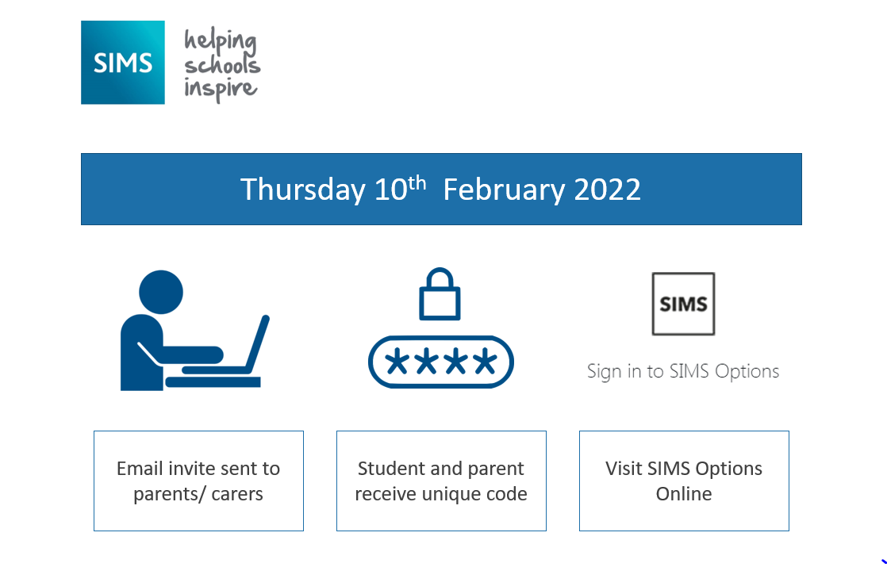
Thursday 11th January 2024
Email sent to students

Slide 11
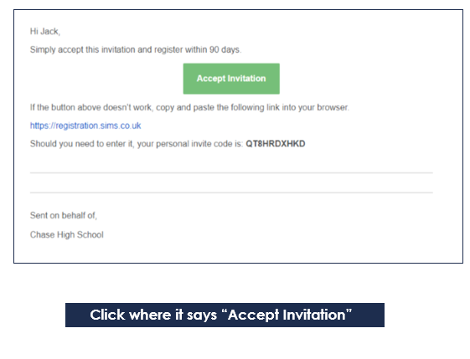
An email from noreply@sims.co.uk will be sent to your school email address to invite you to register for SIMS Options.
Follow the step by step guide Pages 5-10 of the options booklet to activate and register your account

Slide 12
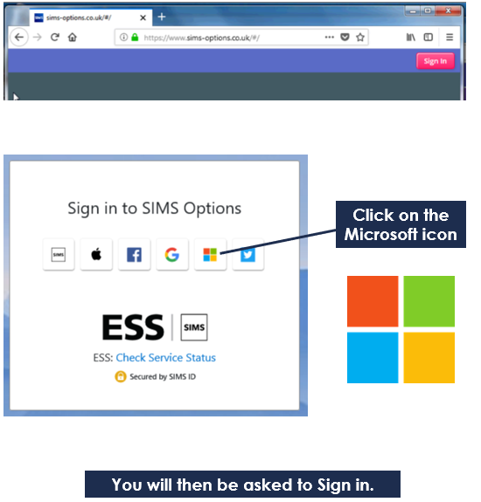
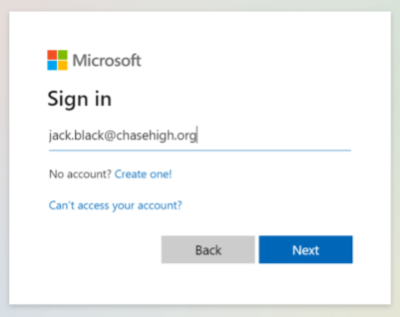
Once registered, you will need to go to the SIMS Options website and login to access the Options page.
Type https://www.sims-options.co.uk
in your web browser and the following page will open:

Slide 13
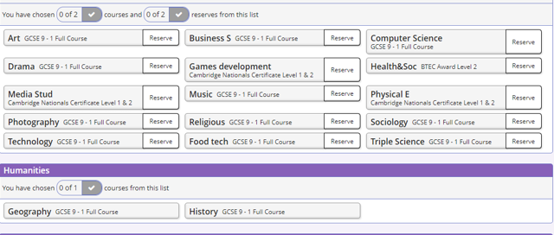
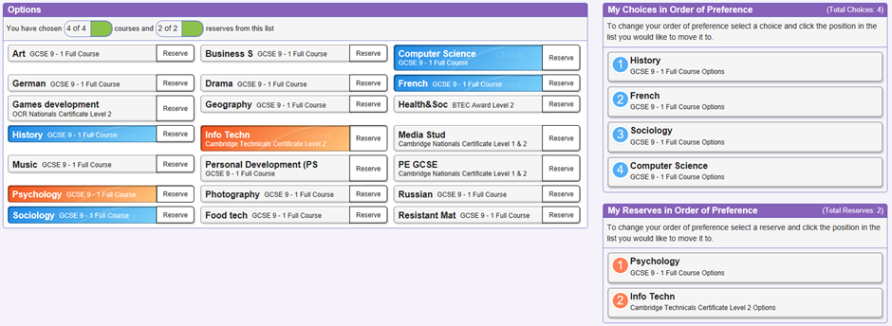
You can then make your choices by clicking on the course items from the screen displayed. You will have sections for guided choices and free choices
When choosing ‘free choices’ remember to do this is order of preference and choose 2 reserves which will go orange.

Slide 14
Selecting Options
What SHOULD influence choice
Enjoyment
Talent
Career
Balance
Recommendation
You SHOULD NOT be influenced by:
Friends
Liking a teacher
Thinking that any course is easy… they are all demanding

Slide 15

What happens next?
Ensure that your child selects their option subjects in the order of preference, so that they have a greater chance of receiving their top choices.
We will endeavour to allocate your child their choices, but cannot guarantee all choices.
Your child will find out their choices in June when the timetable has been finalised.

Slide 16
Who can your child ask for help?
Form Tutor
Subject Teachers
Mr Baxter, Head of Year 9: Richard.Baxter@chasehigh.org
Mrs Ringrose, Year 9 Administrator: Natasha.Ringrose@chasehigh.org
Mrs Lamb, Head of Key Stage 3: Amy.Lamb@chasehigh.org
Mr Brodigan, Assistant Headteacher –Exams and Timetable:
Colin.Brodigan@chasehigh.org
More detailed information about the content of the examination courses offered can be found on the “Subjects” page of the Chase High School website:
https://www.chasehigh.org/curriculum/subjects

Slide 17
Role of the parent/carer
Support
Guidance – who to talk to
Informed – understand the process and implications
Work with us
Ensure that online form is completed by Thursday 1st February 2024

