Slide 1




Mr Brodigan - Asst. Headteacher – Exams and Timetable
Ms. Thompson - Head of Year 9

Slide 2


Slide 3

Curriculum in Year 10 & 11
50 periods per fortnight
Core Curriculum
English 9
Maths 9
Science 9
Core PE 2
RE 1
PSHE 2
Options
Option W 6
Option X 6
Option Y 6

Slide 4

The Choices

Slide 5

Thinking of University?
We are ambitious for you to have the same chances as students in all other schools, so the EBacc is core to our curriculum offer:
All students MUST choose either History or Geography or French or German
To obtain the English Baccalaureate you need to choose a second from that list
You do not need to obtain the English Baccalaureate

Slide 6
EBacc
Geography
History
French
German
Optional Curriculum
Art and Design
Business
Creative Media
Design and Technology*
Information Technology
Music
Performing Arts
Photography
Religious Studies
Sociology
Sport
Food Preparation and Nutrition*
Health and Social Care
Psychology
When choosing it is important to note that some options subjects cannot be studied together- this is because they are considered variations of the same qualification.
These subjects have been highlighted:
Art and Design & Photography.

Slide 7
Why the * on Technology and Food?
Design and Technology
Food Preparation and Nutrition
Two routes
Design and Technology GCSE
Construction L2
Two routes
Food Preparation and Nutrition GCSE
Hospitality and Catering L2

Slide 8
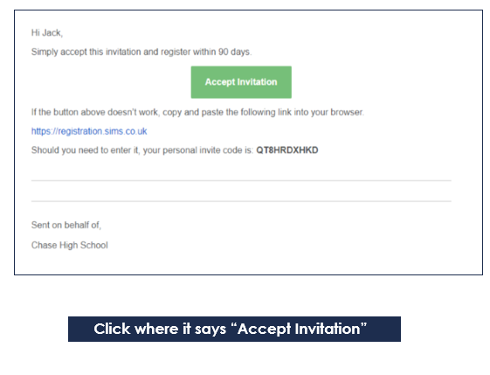
An email from noreply@sims.co.uk will be sent to your school email address to invite you to register for SIMS Options.
Follow the step by step guide Pages 5-10 of the options booklet to activate and register your account

Slide 9
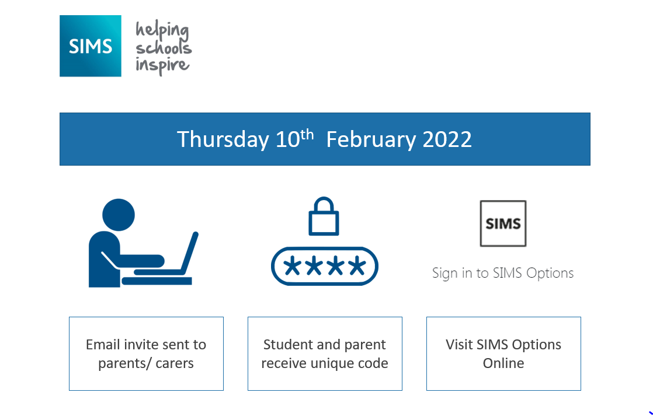


22nd January – 22nd February 2026
Email sent to students

Slide 10
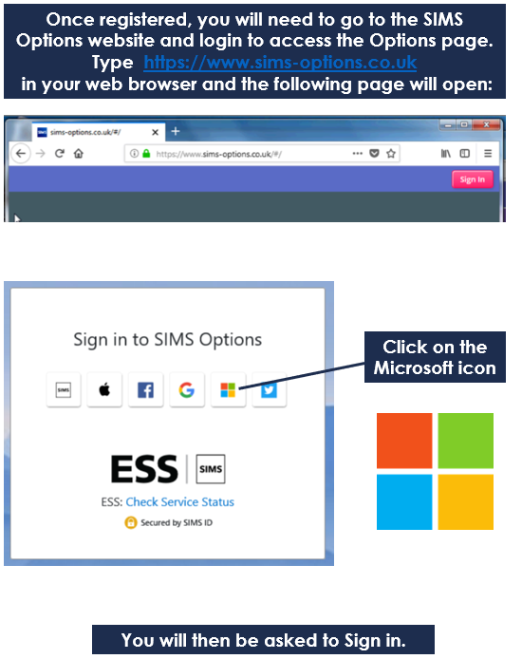
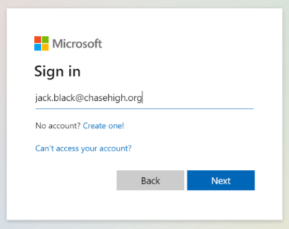
Once registered, you will need to go to the SIMS Options website and login to access the Options page.
Type https://www.sims-options.co.uk
in your web browser and the following page will open:

Slide 11
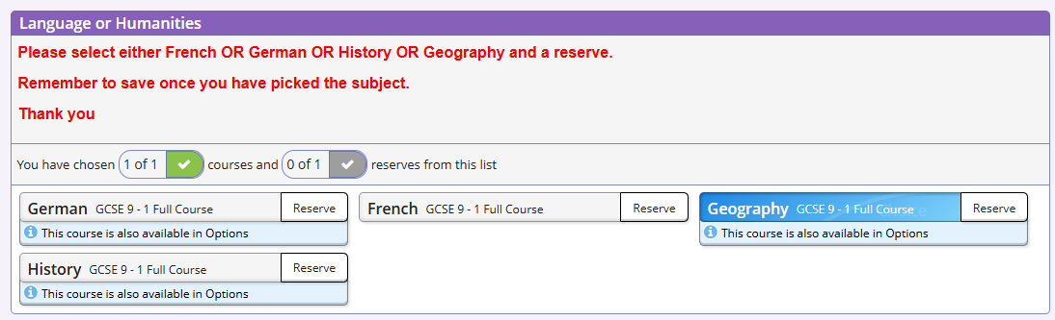
You can then make your choices by clicking on the course items from the screen displayed. You will have sections for guided choices and free choices

Slide 12
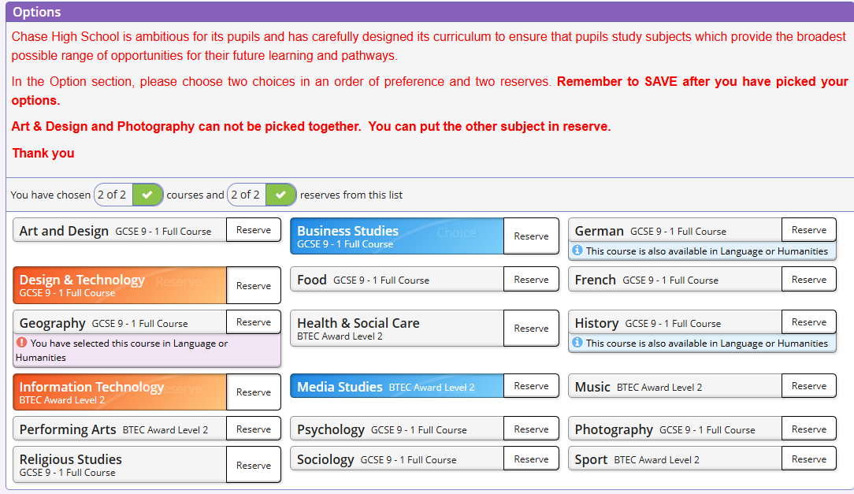
When choosing ‘free choices’ remember to do this is order of preference and choose 2 reserves which will go orange.

Slide 13
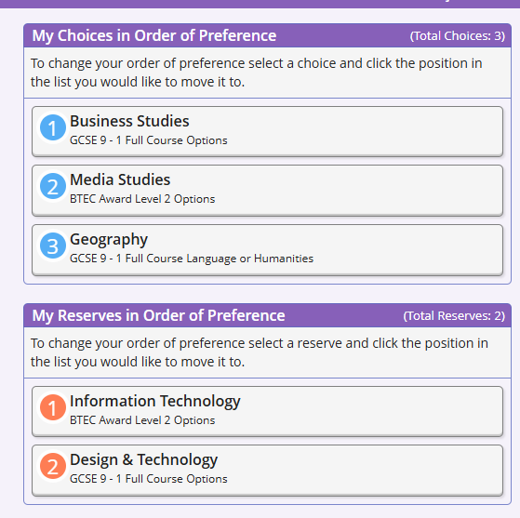

Slide 14
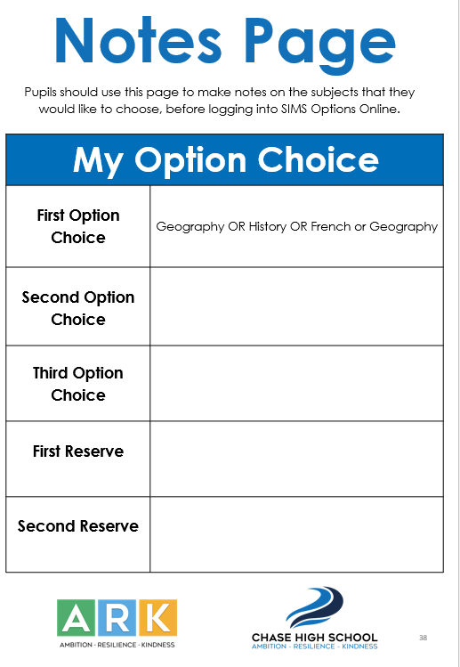

Slide 15

Selecting Options
What SHOULD influence choice
Enjoyment
Talent
Career
Balance
Recommendation
You SHOULD NOT be influenced by:
Friends
Liking a teacher
Thinking that any course is easy… they are all demanding

Slide 16
What happens next?
Ensure that your child selects their option subjects in the order of preference, so that they have a greater chance of receiving their top choices.
We will endeavour to allocate your child their choices, but cannot guarantee all choices.
Your child will find out their choices in June when the timetable has been finalised.

Slide 17


